Slide 1
Workflow Recovery System
Eastern Eagles Team:
Mateusz Gołąb
Csaba Kerti
Jakub Kiełbasa
Zsolt Kollarits

Slide 2
Presentation Plan
Team Management [short Kuba]
Goals and Objectives [short Kuba]
Design Applied [Mat]
Testing Strategy [Csaba]
Prototype Demonstration [Zsolt]
Costs Identification [short Zsolt]
Summary and Discussion [all]
Notes:
Sept 2010

Slide 3
Team Management

Slide 4
Team Management

Slide 5
Team Management

Slide 6
Team Management

Slide 7
Goals of the Project

Slide 8
Goals of the Project

Slide 9
Goals of the Project

Slide 10
Design of the Project

Slide 11
Design of the Project

Slide 12
Design of the Project

Slide 13
Design of the Project

Slide 14
Design of the Project

Slide 15
Testing Strategy

Slide 16
Testing Strategy

Slide 17
Testing Strategy

Slide 18
Testing Strategy

Slide 19
Testing Strategy

Slide 20

Implementation
THE TECHNOLOGIES USED
Decision-making principles:
Wide applicability
Large customer base
= Multi-platform availability
The most appropriate choice for this purpose:
JAVA - programming language
SSH protocol – for communication

Slide 21
Implementation
MULTI-PLATFORM BEHAVIOUR
JAVA:
Ideally, this means Java can be developed on any device,
compiled into a standard bytecode and be expected to run
on any device equipped with a Java .virtual machine (JVM).
SSH:
Can be used for many applications across many platforms (i.e. Windows, Linux, Mac).
The SSH Server runs on UNIX, Linux and VAX. Client runs on the above, plus Windows
and many other platforms.

Slide 22
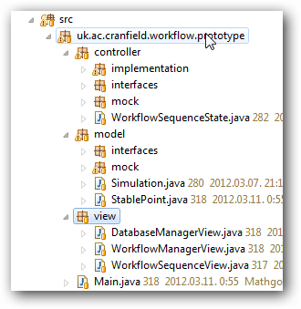
Implementation
Implementation
STRUCTURE OF THE PROGRAM
Features:
Just a PROTOTYPE
Not imlemented all the components
The program is well-structured.
/ Controller-Model-View form /

Slide 23
Implementation
STRUCTURE OF THE PROGRAM
Implemented modules:
Recovery function of the system
(WorkflowManager, WorkflowQueue and WorkflowSequence classes)
Environment
Special components (called MOCK) generate
the appropiate environment for adequate running
Implemented scenarios
Workflow execution success
Workflow execution failure, recovery succes
Workflow execution failure, recovery failure

Slide 24
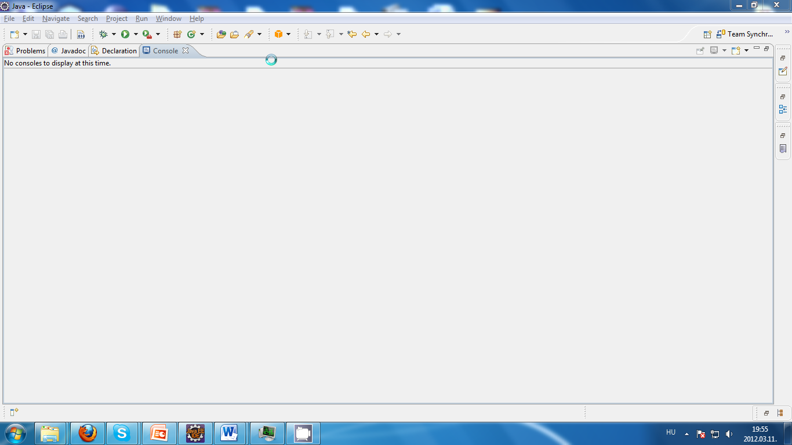
Demonstration

Slide 25
Costs

Slide 26
Costs

Slide 27
Costs

Slide 28
Summary

Slide 29
Question?

